Slide 1

Enhance Teaching and Learning with MATLAB and GenAI
Gerald Reymari Cagayan
Application Engineer
TechSource Computing Solutions, Inc.

Slide 2
https://tinyurl.com/USAMATLABPortal
https://tinyurl.com/USAMATLAB

Slide 3
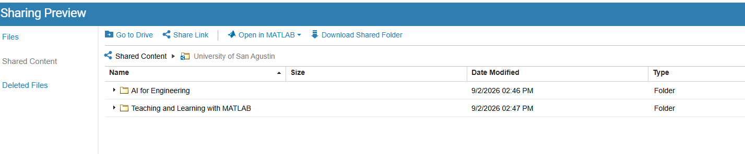
https://tinyurl.com/USAMATLAB

Slide 4
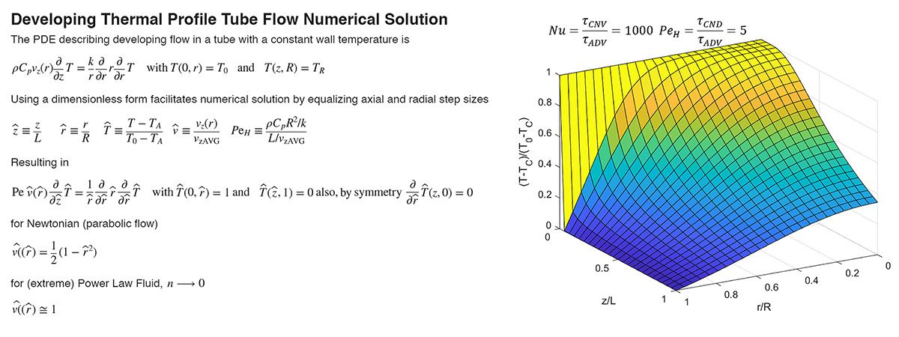
Teaching Students to Solve Complex Heat and Mass Transfer Problems with MATLAB
A NJIT professor uses MATLAB, Symbolic Math Toolbox, and Partial Differential Equation Toolbox to teach students how to solve heat and mass transfer problems, better preparing them for complex, real-world applications.
Key Outcomes
  MATLAB enabled students to master engineering concepts while executing math operations error-free
  Powerful visualizations helped students validate their assumptions when solving heat and mass transfer problems
  Using MATLAB, students gained the necessary problem-solving abilities needed to address real-world engineering challenges
Development of a thermal profile tube flow numerical solution.
“MATLAB can be used to automate complex math calculations, which allows more time for students to learn engineering problem-solving skills and extrapolate those skills to more complex, real-world applications beyond just heat and mass transfer.”
- Donald Sebastian, professor of chemicals and materials engineering, New Jersey Institute of Technology
Link to user story

Slide 5
What We’re going to Discuss?
MathWorks Products
MATLAB, Simulink & Toolbox
MATLAB & Simulink Online, and MATLAB Drive
1
Challenges in Teaching
MATLAB in Education
Course Mapping
Campus Wide License
2
Teaching with MATLAB
Live Script
Online Training Service
Course Mapping
3
MATLAB Features
MATLAB Copilot
Teaching in the Era of GenAI.
Student Competitions.
4

Slide 6


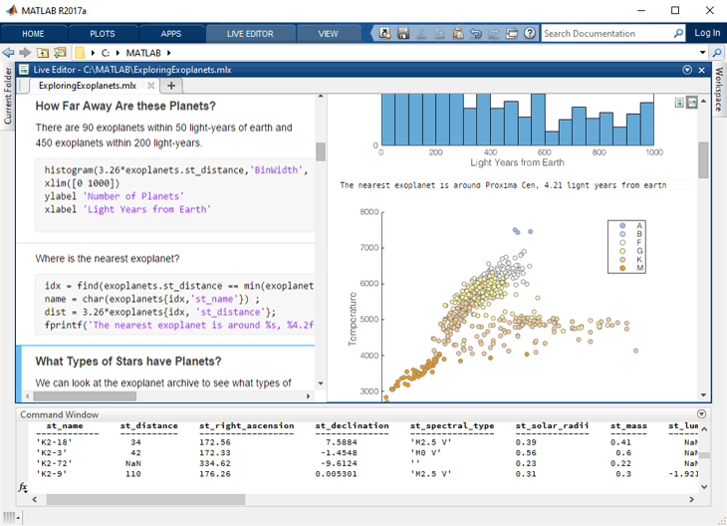
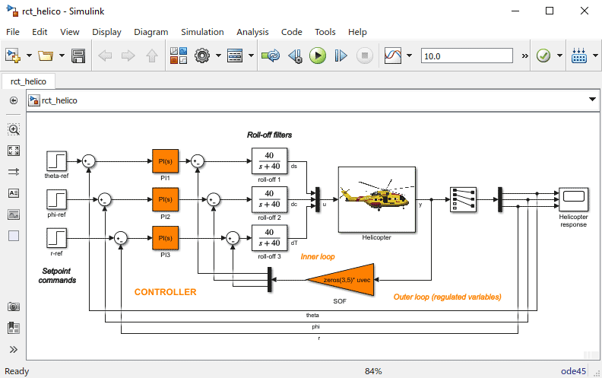
MATLAB
Simulink
Helicopter Simulation Model
MATLAB is a programming environment for algorithm development, data analysis, visualisation, and numerical computing.
Simulink is a graphical environment used for the design, simulation, and testing of the system.
130+ additional toolboxes for specialised tasks.

Slide 7
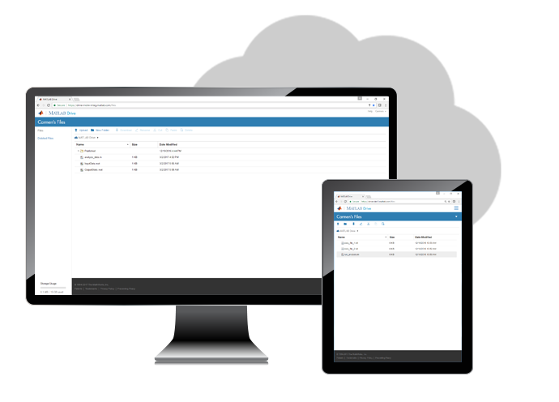
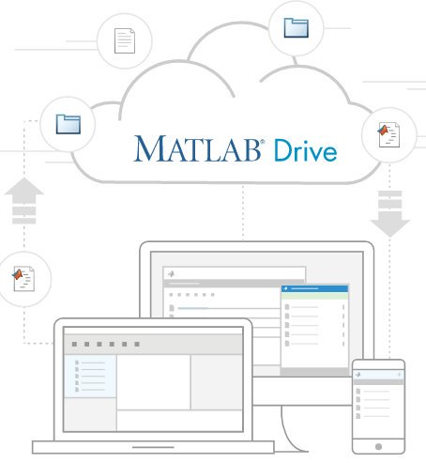
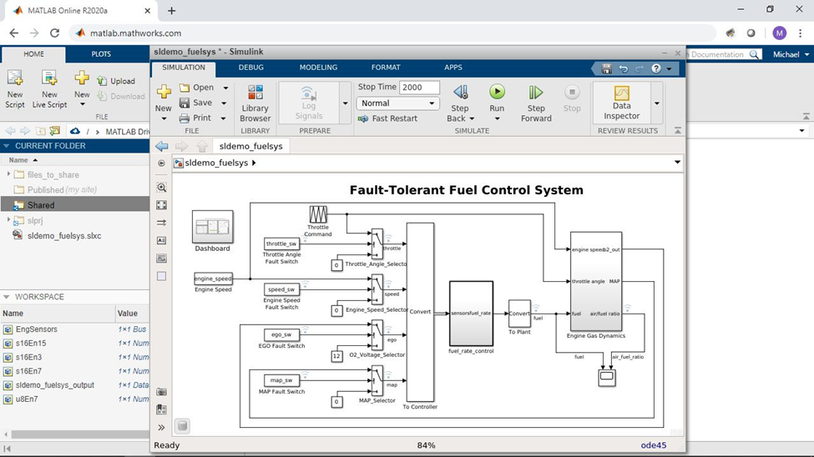
MATLAB & Simulink Online
MATLAB Drive
Requires no download or installation of MATLAB or Simulink.
Always available with the most current version.
Uses only the web browser.
Ideal for teaching, learning, and with convenient & lightweight access.

Slide 8


What matters to you?
In preparation of a Math Course…
Engage students
(Attractive lectures!)
Equip students with proper tools for industry
Figure out
how to solve
Challenges
Fundamental
theory
Apply Math concepts to
new problems
Stimulate student’s interest
(team projects!)

Slide 9




What matters to you?
Create a Library
Define a Playground
$$v=\frac{dx}{dt}$$
Statistics
PDE
Algebra
$$F=m\ddot{x}$$

Slide 10




Challenges in Teaching
Interesting Subject, Engaged Students
Visualising Functions
Connect with Real Problems
Learning by Doing
Developing an Intuition of Complex Topics
Applying Concepts

Slide 11




Deeply Rooted in Education
“MATLAB can be used to automate complex math calculations, which allows more time for students to learn engineering problem-solving skills and extrapolate those skills to more complex, real-world applications beyond just heat and mass transfer.”
- Donald Sebastian, Professor of Chemicals and Materials Engineering, New Jersey Institute of Technology.
MATLAB and Simulink are the tools of inspiration and innovation used by students, educators, and researchers around the world.
7000+
Schools
teach with our software
2400+
MATLAB and Simulink-based books
Tens of Thousands
of skilled graduates enter the workforce each year

Slide 12
Campus-Wide Access to MATLAB and Simulink
With Campus-Wide access to MATLAB and Simulink, all faculty, staff, students, and researchers get unlimited use of desktop and online products, on and off campus, on any device.
Support Student Success in the Classroom
Self-Paced Courses: Increase MATLAB proficiency with interactive online courses. | MATLAB Grader: Create interactive, auto-graded course assignments with instant learner feedback.
Additional Classroom Resources: Enhance curricula with ready-to-use courseware and tools. | MATLAB Onramp: Get students up to speed quickly on MATLAB with a free, two-hour tutorial.
Teaching with MATLAB: Learn best practices for teaching with MathWorks online learning tools. | MATLAB Online Collaborate more efficiently on projects through MATLAB Online with MATLAB Drive.

Slide 13
Campus-Wide Access to MATLAB and Simulink
Enhance Research and Foster Collaboration
MATLAB Live Editor: Create computational code stories in an executable notebook. | MATLAB Parallel Server: Prototype and debug applications and scale to clusters without recoding.
MATLAB Drive: Share data and code. | MathWorks File Exchange: Access shared code and custom toolboxes.
Prepare for In-Demand Careers
Computational Thinking: Support computational thinking tasks with MATLAB courseware. | MathWorks Startup and Accelerator Program: Develop products and reach early-stage milestones fast with MATLAB and Simulink.
Project-Based Learning: Create cool projects while building valuable expertise.

Slide 14
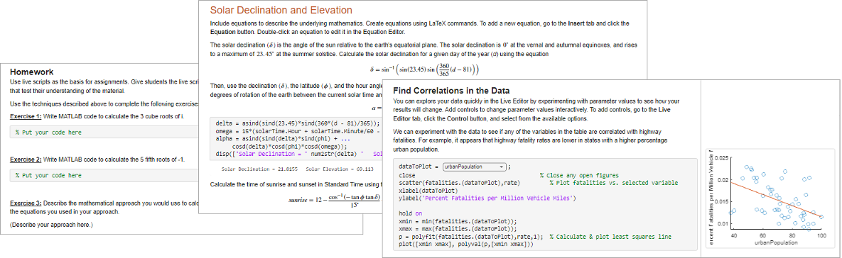
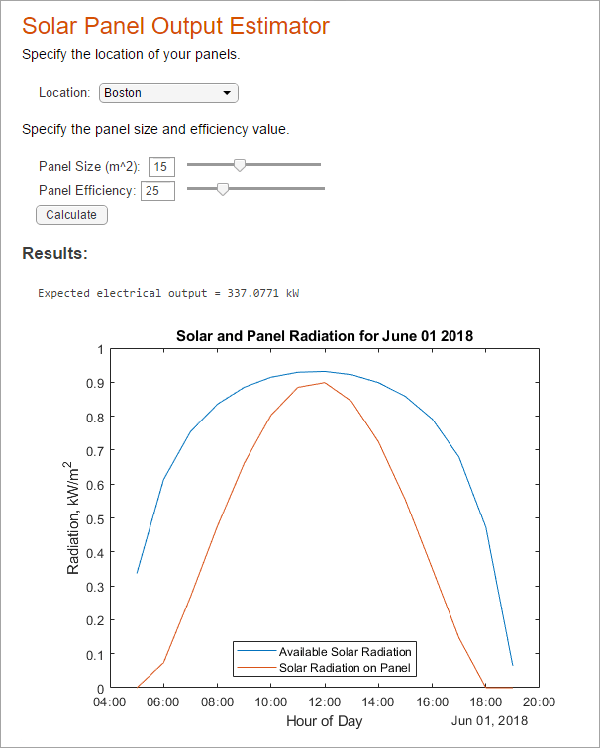

Live Script: Computational Notebooks with Live Editor
  Create engaging lectures.
    Add interactivity.
    Code, text, images & outputs together.
  Share live scripts directly with colleagues or students.
    Export as report (pdf, docx, etc).
  Work in a single environment to eliminate context switching.

Slide 15
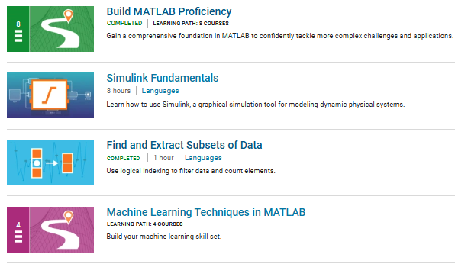
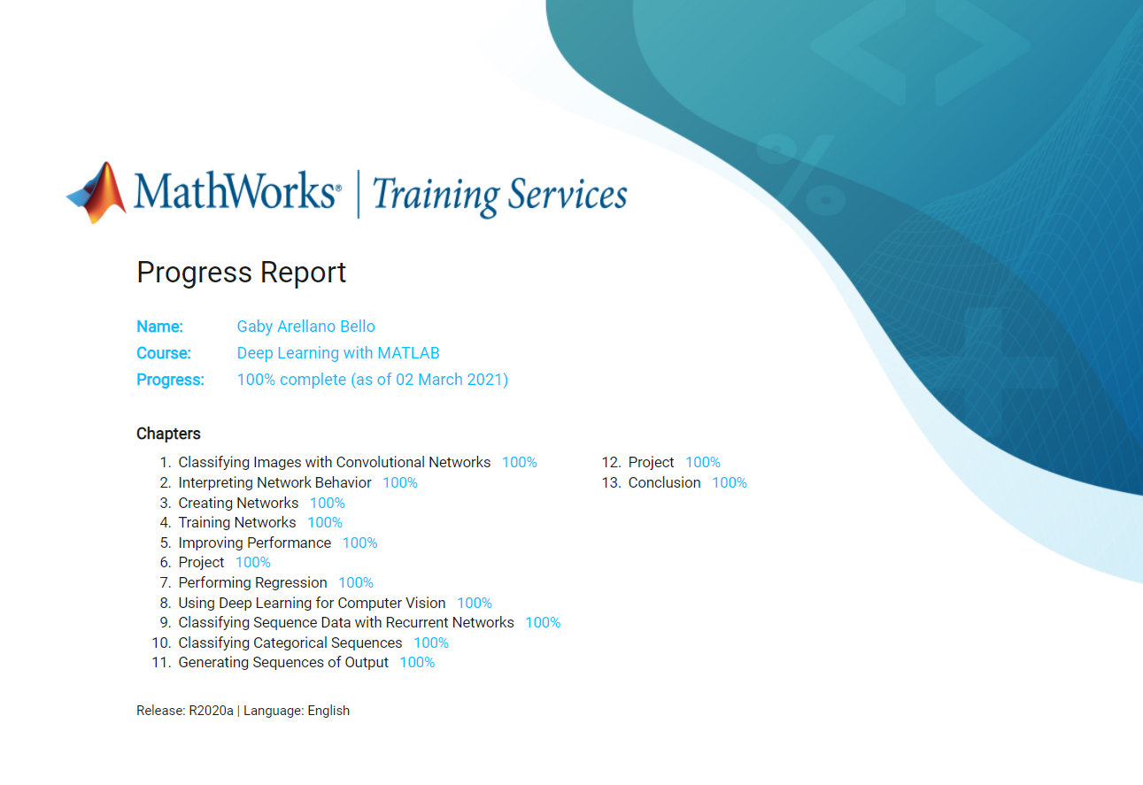
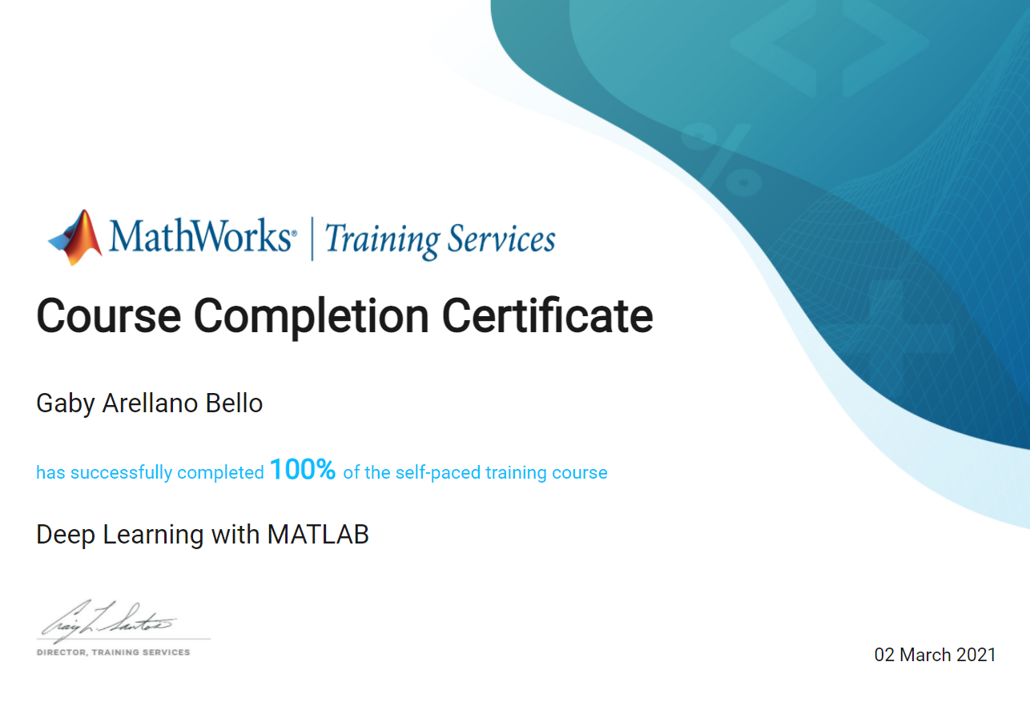

Online Training Suite
Learn MATLAB and Simulink at your own pace.
Key benefits:
One year access to online courses through your web browser.
Coding exercises & assessments.
Sharable progress and completion credentials.
Explore lessons, courses, or full learning paths.
A wide range of topics.
See what content is in the Online Training Suite.

Slide 16
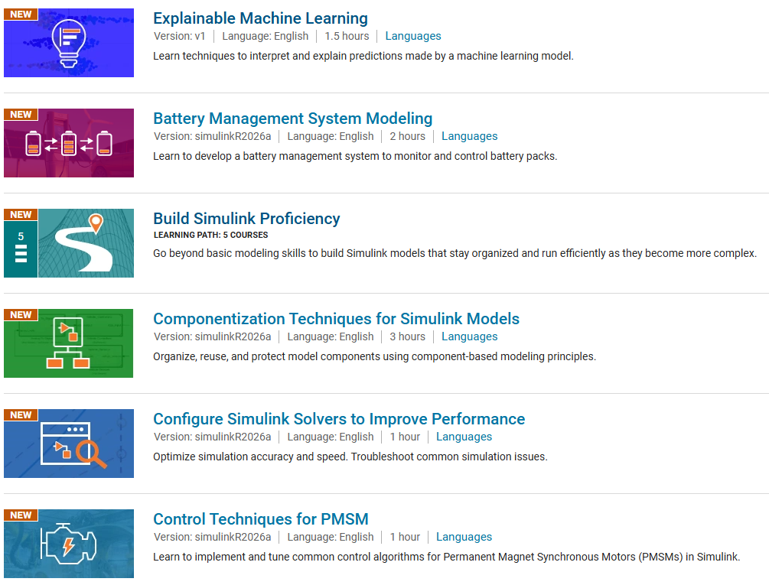
Online Training Suite
Build skills faster with unlimited access to self-paced MATLAB and Simulink learning.
Training Catalog Preview
80 Short Courses
Quick lessons for targeted upskilling and fast onboarding.
18 Learning Paths
Guided sequences that take learners from basics to applied skills.
26 Onramps
Brief introduction to the tool with hands-on practice. Test drive/trial MATLAB and Simulink. Sometimes a prerequisite for longer courses.
Flexible formats
Choose individual lessons, full courses, or curated learning journeys.
Always expanding
New topics are added regularly to keep teams current.
Self-paced • Practical • Easy to scale
Browse the full course list at matlabacademy.mathworks.com
Notes:
Learning Path
Curated content for specific workflows & learning goals
Provide a structured learning journey
Paths show a recommended order
Onramp:
Introduction to the Online Courses learning interface
Helps learners get started with tools or applications
Sometimes a prerequisite for longer courses
Can trial OTS before buying

Slide 17







Learning Path Catalog
Self-Paced Online Courses: Learning Paths
Advanced MATLAB Programming Skills
Image Segmentation and Analysis in MATLAB
Build MATLAB Proficiency
Machine Learning Techniques in MATLAB
Build Simulink Proficiency
MATLAB for the MathWorks Certified MATLAB Associate Exam
Control System Design with MATLAB and Simulink
MATLAB Skills for Simulink Modeling
Core MATLAB Skills
Motor Control Algorithms with Simulink and Simscape
Core Signal Processing Techniques in MATLAB
Organize Tabular Data in MATLAB
Data Analysis in MATLAB
Programming in MATLAB
Deep Learning Techniques in MATLAB for Image Applications
Software Development in MATLAB
Handle Inconsistent and Unstructured Data Files
Visualization in MATLAB

Slide 18
Electrical and Computer Engineering Course Curriculum
Electives shared between years 3&4
ML/DL
Cryptography
VLSI Digital Des.
Microwave App.
Wireless Comm.
Computer Vision
Comm. Systems
MEMS
Core Math Courses
Semiconductors
Laser Theory
RF Design
Optical Eng.
Courses applying Math
Build Mathematical Modeling skills throughout the curriculum
Comp Foundation
Embedded Sys.
Energy Systems
Power Electronic
Engineering Stats
Controls
Hardware Sys
Electromagnetics
Robotics
Physics
Circuit Analysis
Microelectronics
Digital/Analog Cir
Linear Algebra
Digital Design
Signals & Sys
Antenna Eng.
Calculus
Signal Pro.
Measure & Circuit
Senior Design
Year 1
Year 2
Year 3
Year 4

Slide 19
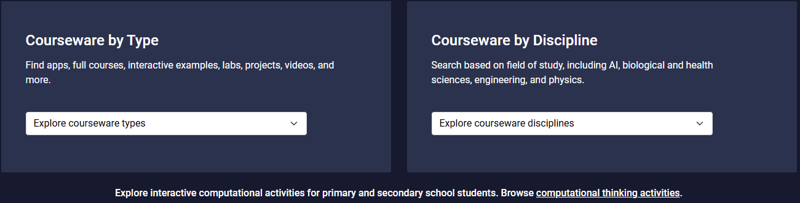
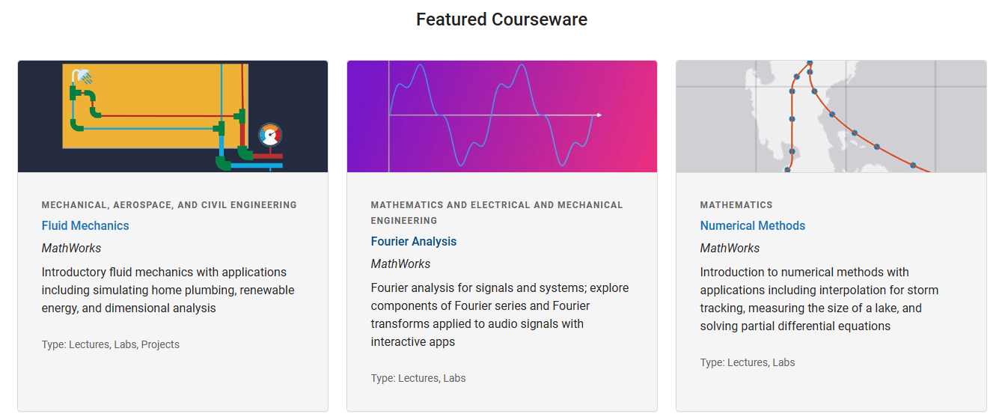
MATLAB and Simulink Courseware
Teaching resource ready to use.
Lecture Notes
Project Ideas
Accompanying code
Get Started Teaching with MATLAB and Simulink - MATLAB & Simulink

Slide 20
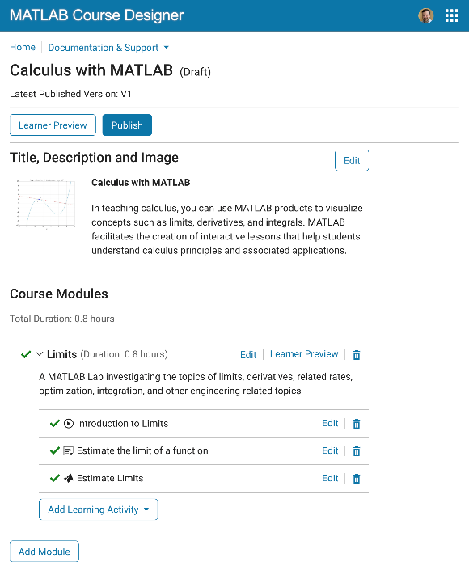
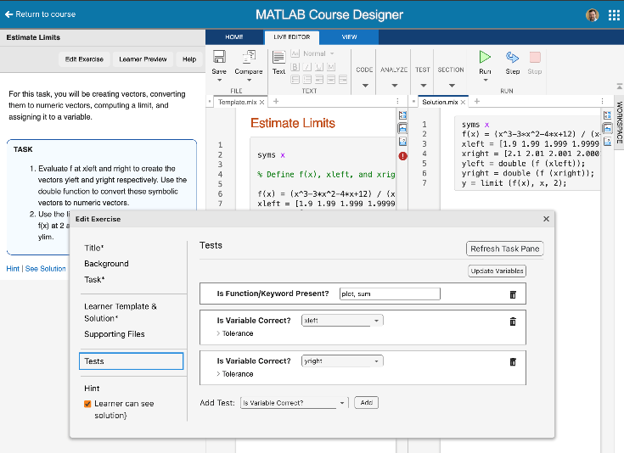
MATLAB® Course Designer™
Build structured learning paths with readings, videos, and MATLAB/Simulink exercises
Automatically grade student work, including Simulink models
Monitor student progress and intervene early
Share content with educators worldwide
1EdTech Certification for LMS integration using LTI 1.3
Create content, courseware, labs, and assessments for your MATLAB and Simulink based courses
course-designer.mathworks.com
Notes:
MATLAB Course Designer allows instructors to create content, courseware, labs and assessments for MATLAB and Simulink based courses.
Instructors can…
Build structured learning paths with readings, videos, and MATLAB/Simulink exercises
Automatically grade student work, including Simulink models
Monitor student progress and intervene early
And Share content with educators worldwide
And all this great learning content can be integrated into your learning management system using industry standards – just like how MATLAB Grader is integrated for may of our customers today.
The product is available to most of our customers on our academic licenses today, and no additional cost. You can simply login to course-designer.mathworks.com today and get started.

Slide 21
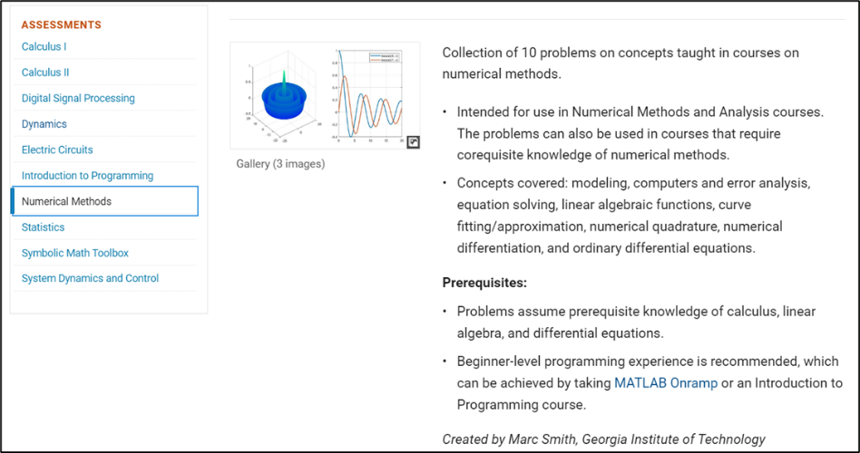

MATLAB Grader
Provide instant feedback to your students by automating code grading.
Create interactive course assignments.
Automatically grade student work and provide feedback.
Run your assignments in any learning environment.

Slide 22
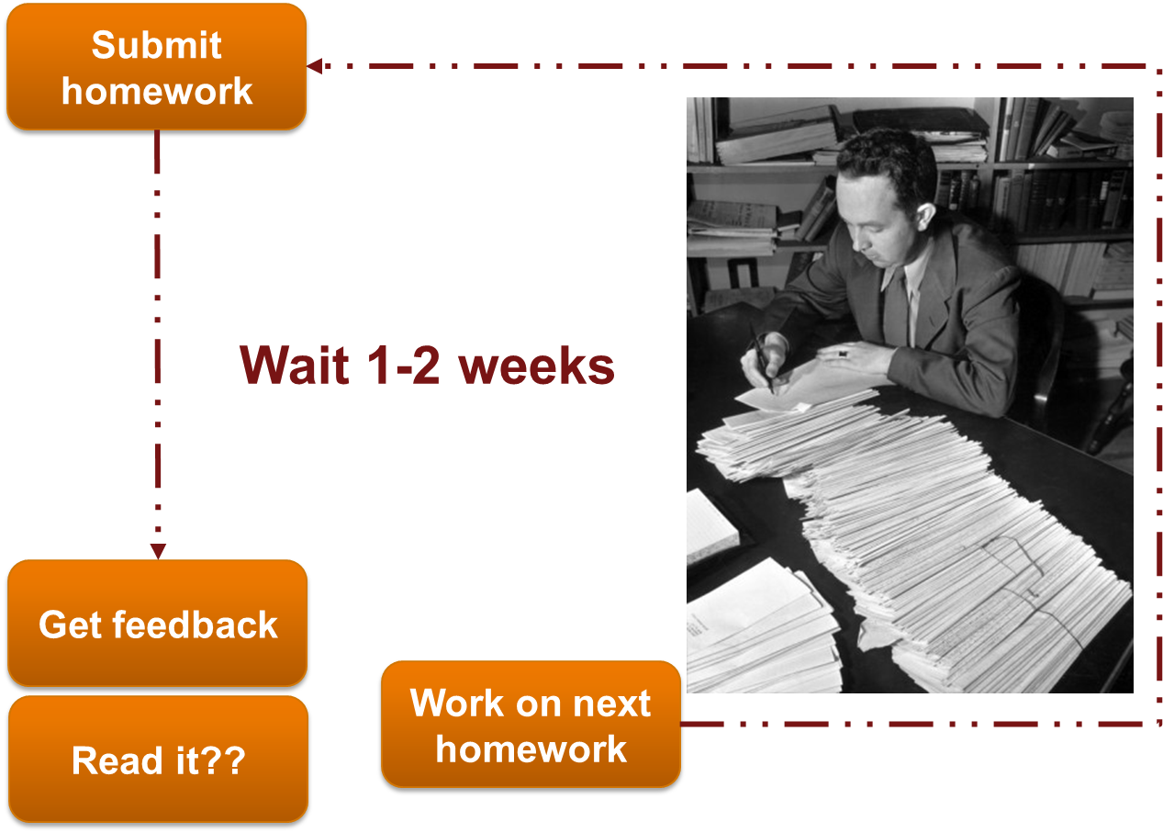
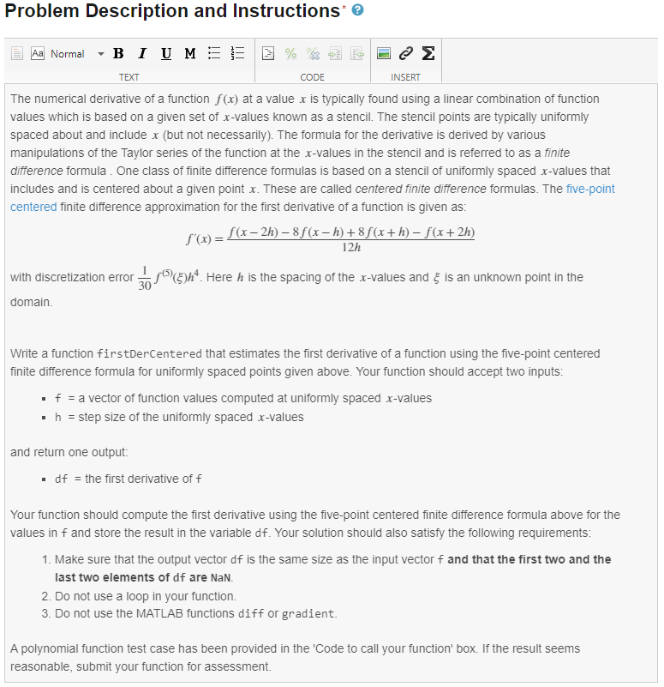
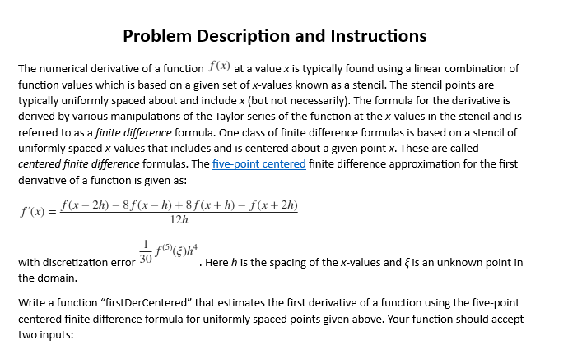
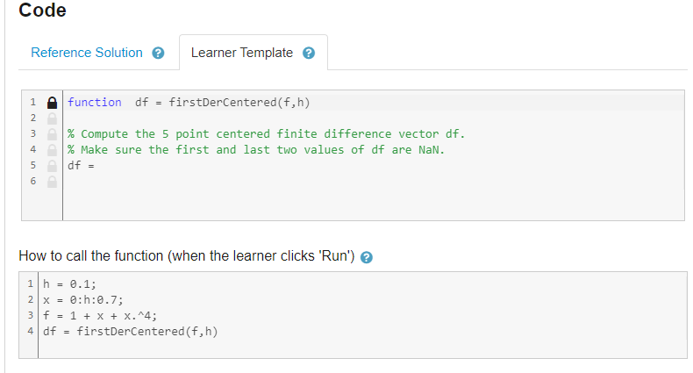
Traditional Grading
Auto-Grading
Submit homework
Instant feedback
Coaching
Improve and learn

Slide 23
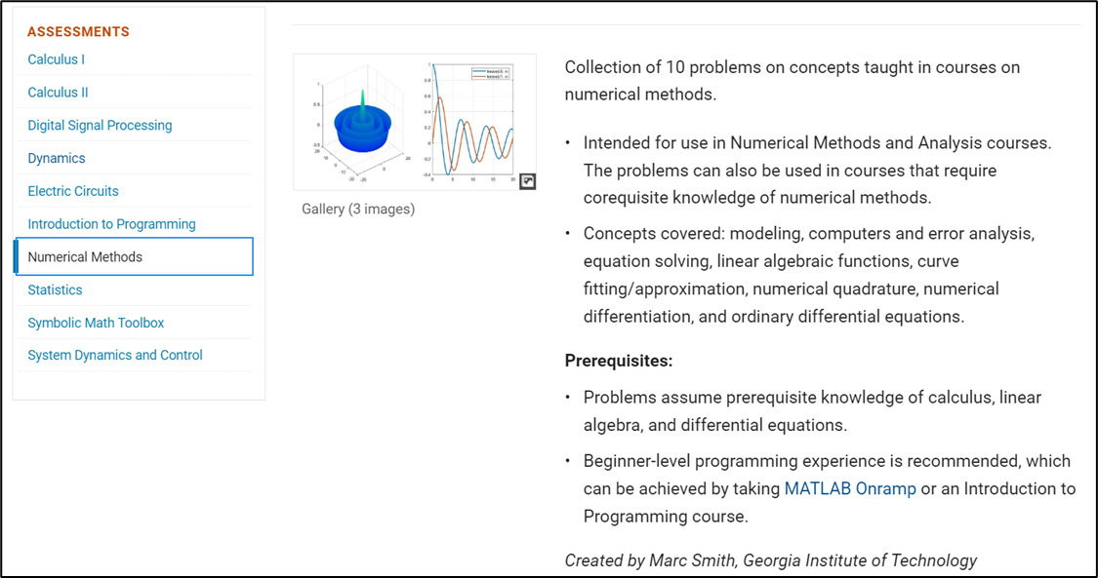
Provide instant feedback to your students by automating code grading
Create interactive course assignments
Automatically grade student work and provide feedback
Run your assignments in any learning environment
https://www.mathworks.com/products/matlab-grader.html

Slide 24
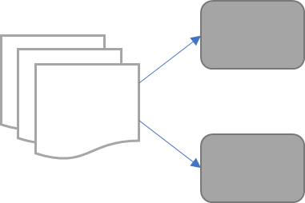
GenAI can help you solve specific problems
Generate Text
Classify Text
Write Code
Document
Classify Maintenance Documents
Analyze Sentiment
Summarize
Retrieve Information
One document
Scientific Discovery
Requirements for design & engineering
Knowledge from internal documents
Multiple documents

Slide 25



Three potential users of Gen-AI
Who are the Gen-AI users in higher education?
Researchers
Students
Educators
Ask general questions on concepts
Ask to generate images
Summarize research/literature review
AI as a Project Partner – help me write this code
AI as a Tutor – explain this code
AI as a Feedback Generator – what’s wrong with my code?
Create syllabus for a new course
Create lecture content based on learning objectives
Update content each term

Slide 26
Adapting to a world with
Generative AI
Requires learning new skills
How to prompt and iterate on a response?
How to process the generated results?
How do I know what the AI’s strengths and weaknesses are?

Slide 27
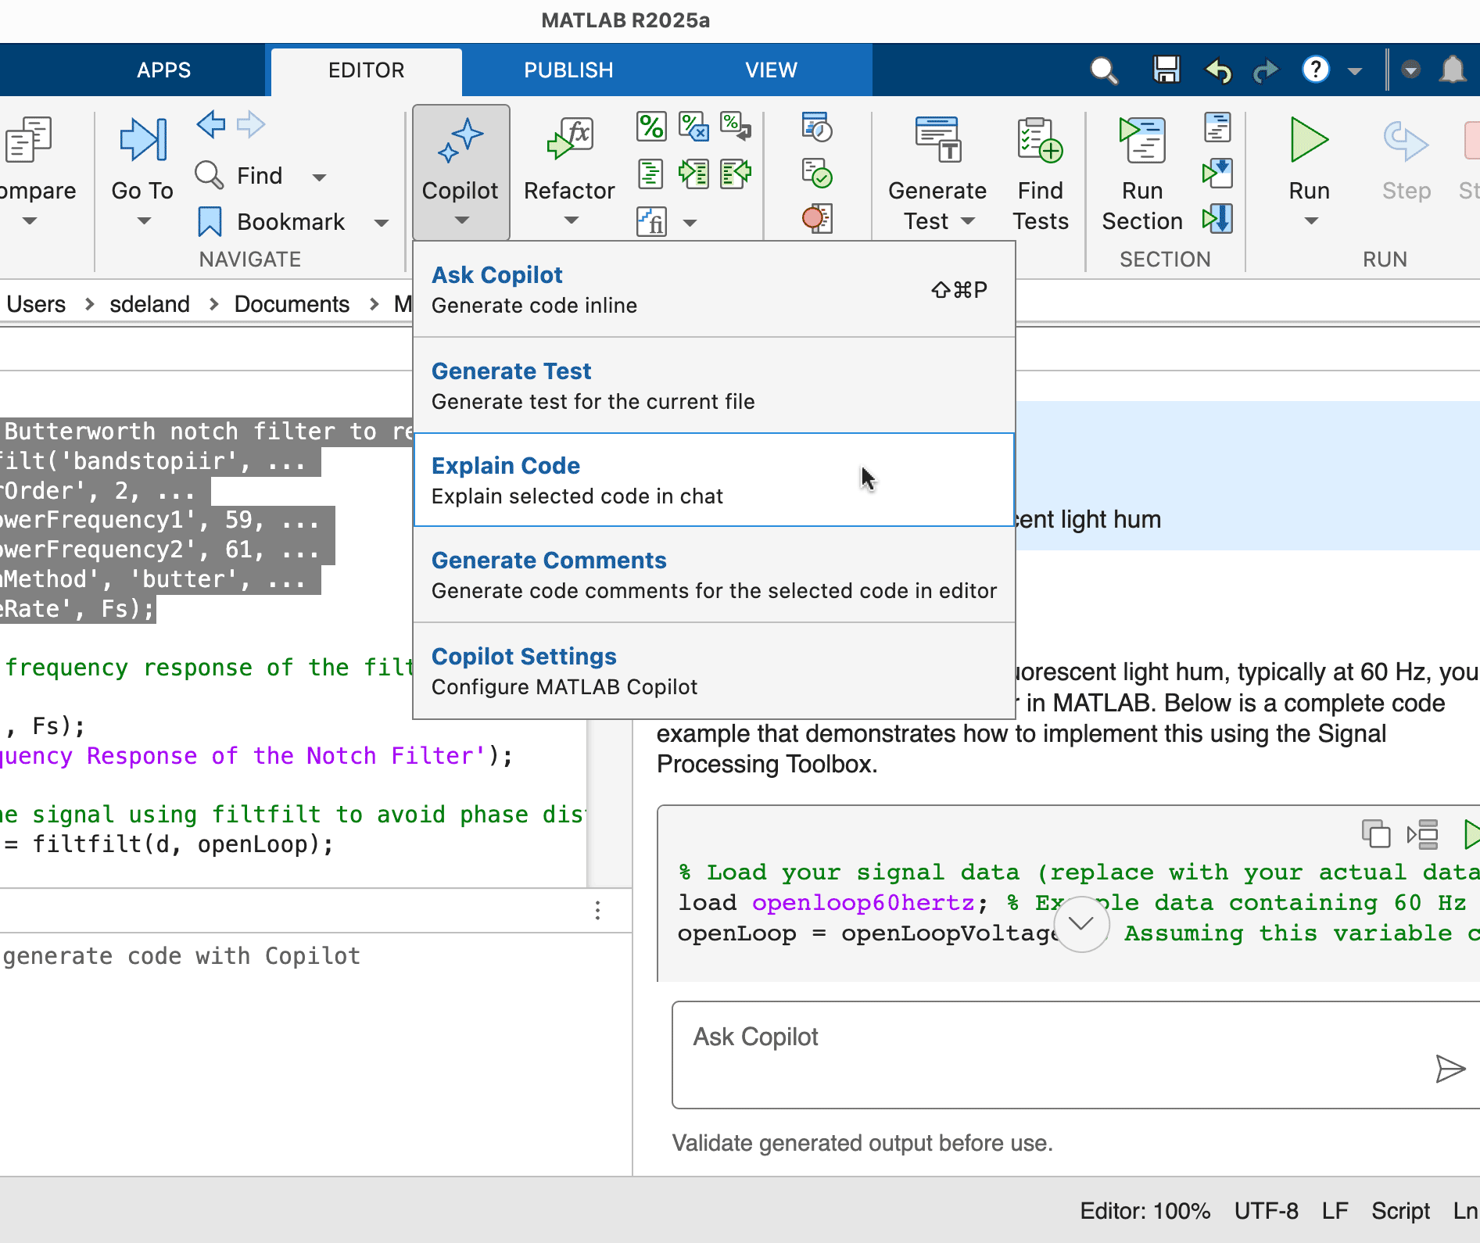
MATLAB Copilot
Evolving Teaching in the Era of GenAI:
MATLAB Copilot provides generative AI-powered capabilities for the MATLAB environment.
Ask questions in the Copilot Chat and get responses based on relevant MathWorks documentation.
Describe the code you want, and MATLAB Copilot will create or modify code for you.
MATLAB Copilot helps with programming by explaining code, error messages, and adding comments.
Automatically generate test cases to verify expected code behavior (with MATLAB Test).

Slide 28
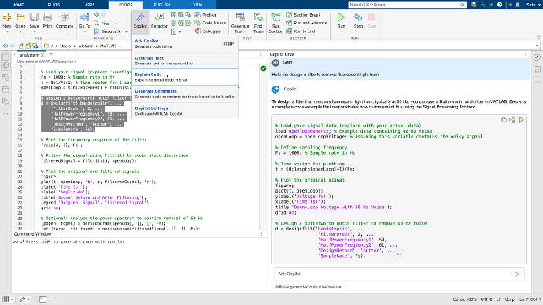
Optimized for MATLAB
Tightly integrated with MATLAB
Responses are based on the latest MathWorks documentation
Tuned for engineering and scientific workflows

Slide 29
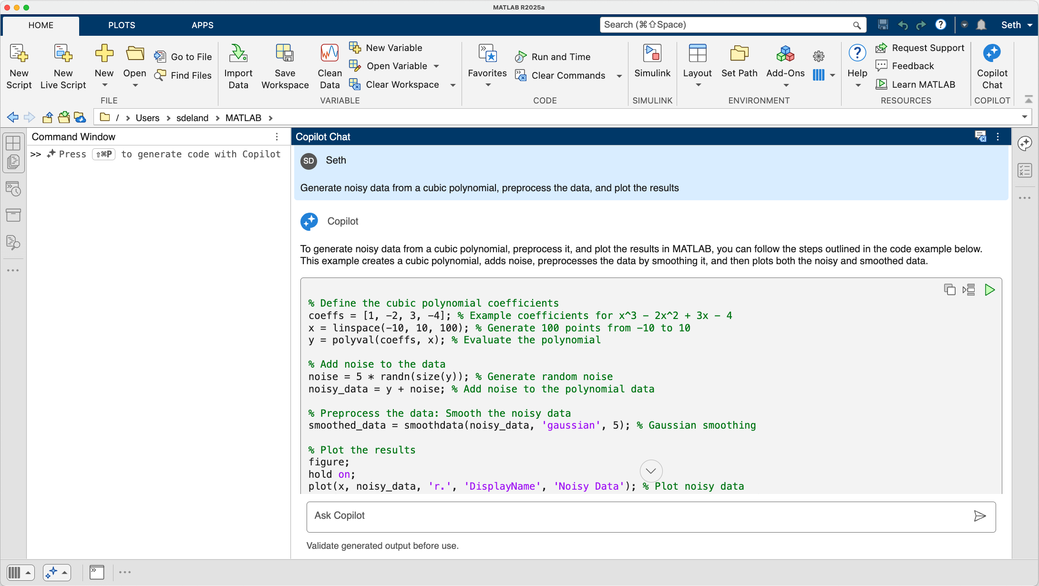
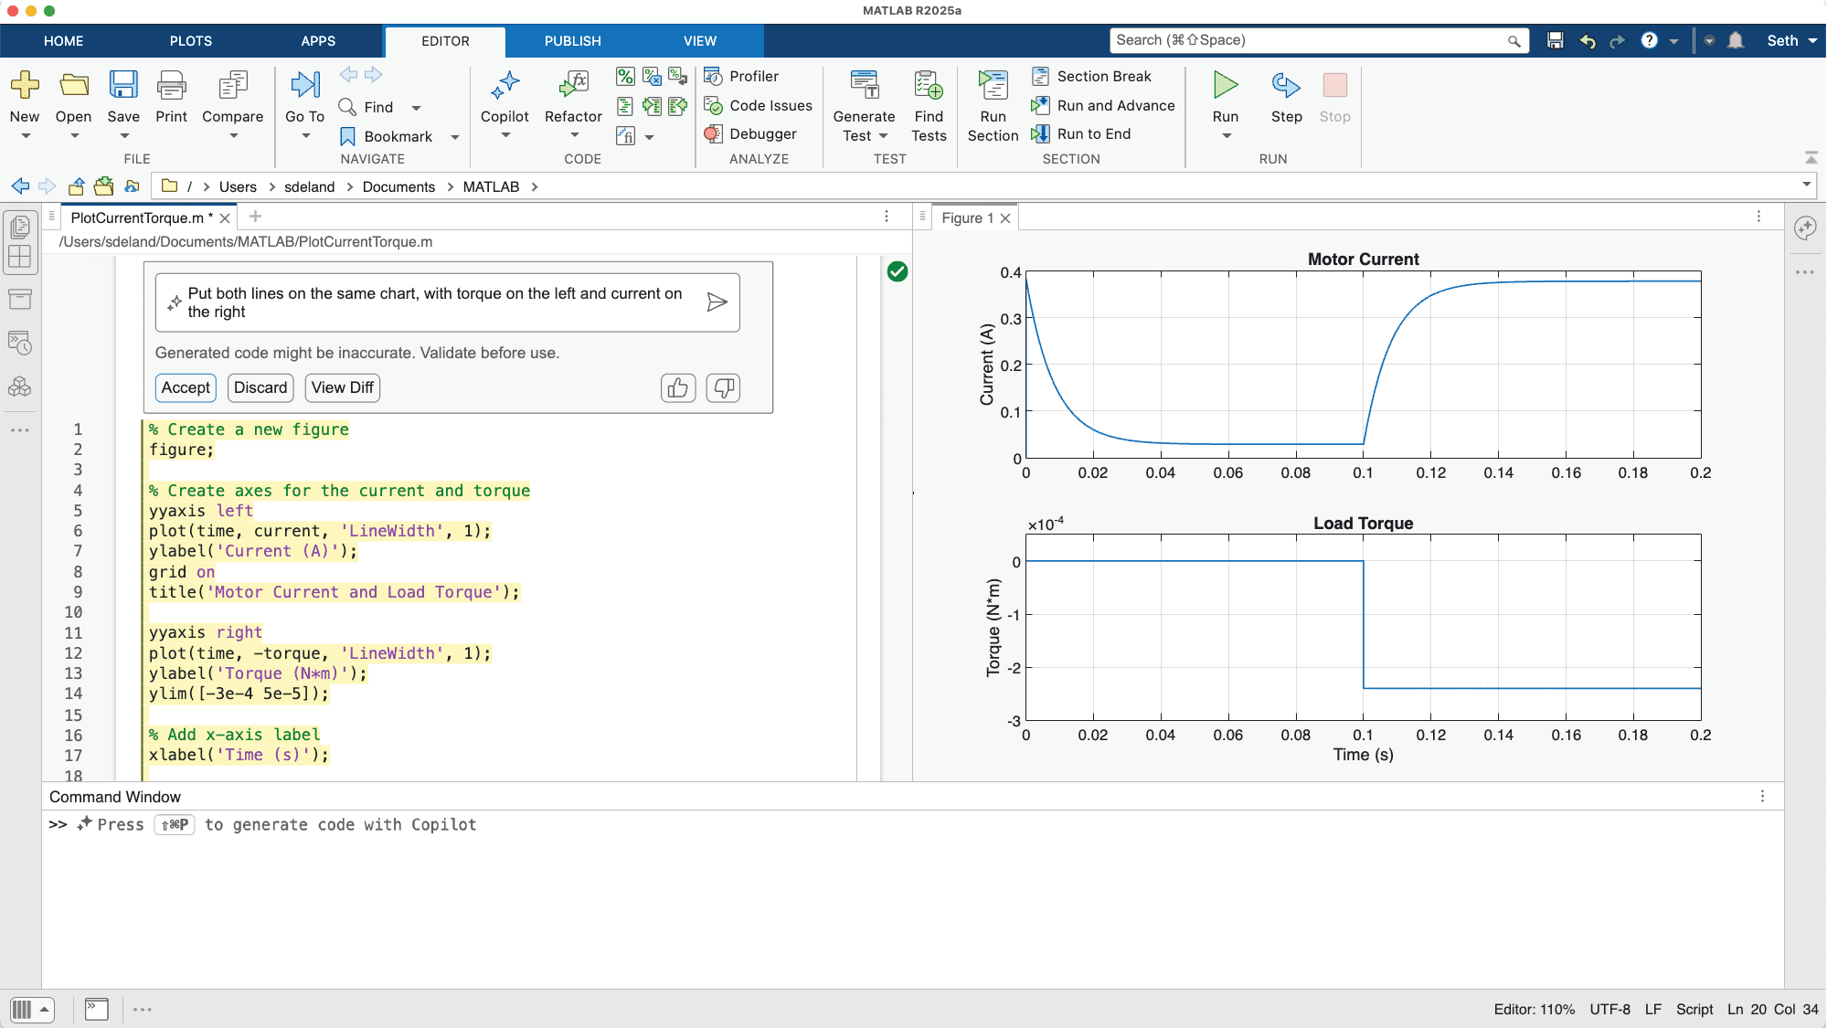
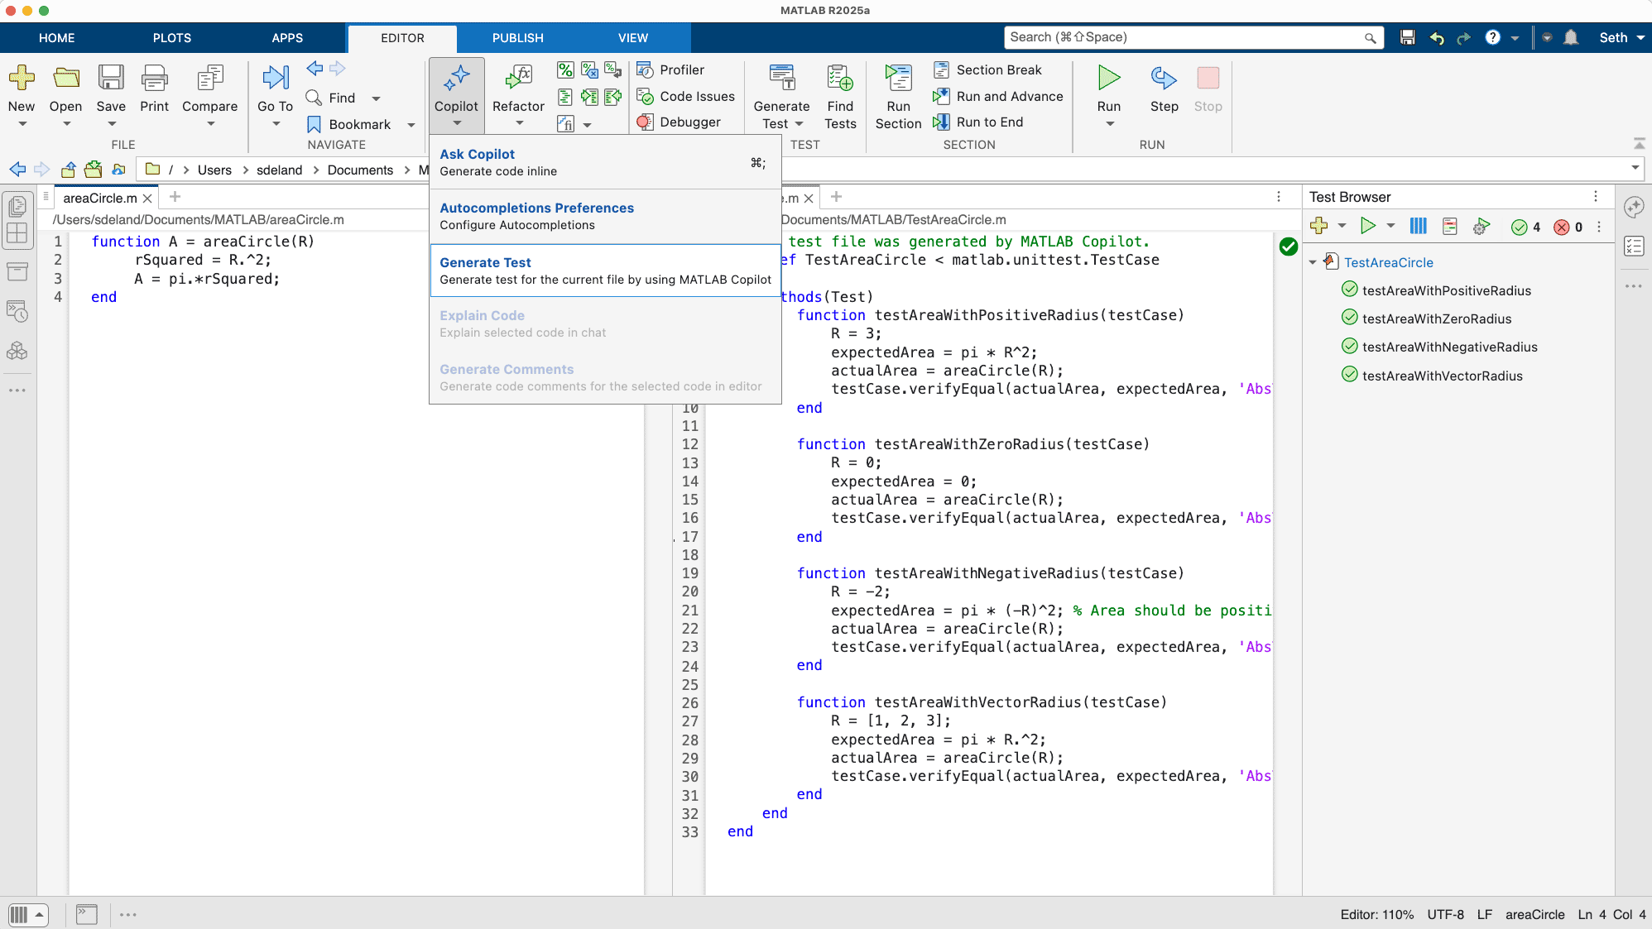
Three ways to use MATLAB Copilot
Copilot Chat
Copilot in the Editor and Command Window
Copilot Actions
1.
2.
3.

Slide 30
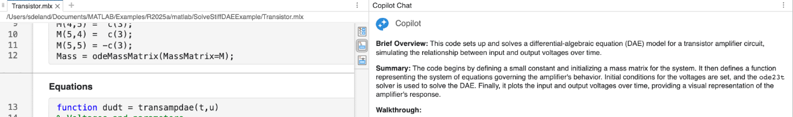
MATLAB Copilot
Common Concerns.
Academic Integrity
  Plagiarism.
  Cheating.
Cognitive Impact
  Decline in student critical thinking and over-reliance on AI.
Bias & Accuracy
  Misleading AI-generated content.
Common Benefits.
Productivity & Efficiency.
  Learning Difficult Concepts.
Virtual tutor.
Skill Alignment with Industry.
Teaching.
  Prompt Engineering.
  Iterative Refinement.
  Assessment of AI-Generated Outputs.

Slide 31
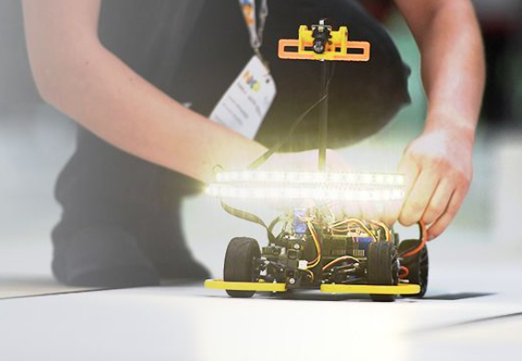
Competitions and Hackathons
Student competitions to challenge your students.
Apply concepts to specific challenge.
Develop soft skills.
Access tutorials from MathWorks.
Project-based experience.
Opportunities to collaborate across disciplines.
Guidance from industry experts.

Slide 32
